Slide 1

CMSC 137
Data Communications and Networking
Lecture Module
01 - Overview

Slide 2
Module 1: Overview
Rozano S. Maniaol
Lecturer

Slide 3
“What hath God wrought?”
Samuel F. B. Morse
Transmission of the first telegraph message on 24 May 1844 from Supreme Court chamber in Washington, D.C. to the B&O's Mount Claire Station in Baltimore, Maryland

Slide 4
Introduction
Data communications and networking have changed the way we do business and the way we live
Decision makers who require immediate access to accurate information can get it instantaneously
Communities in the world are not isolated anymore

Slide 5
Terms
Communication – information sharing, local or remote
Telecommunication – communication at a distance
Data communication – exchange of data between devices via some form of transmission medium such as wire cable
Data – information presented in whatever form agreed upon by parties creating and using the data
Communicating devices must be part of a data communication system (DCS), a combination of hardware and software

Slide 6
Effectiveness of a DCS
Delivery
  must deliver data to the correct destination
Accuracy
  must deliver data accurately
Timeliness
  must deliver data in a timely manner
Jitter
  variations in the packet arrival time

Slide 7

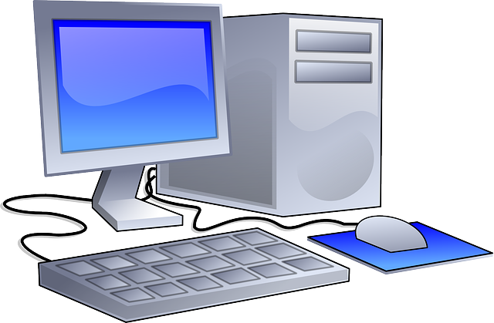

Components of a Data Communication System
Message
Protocol
Sender
Medium
Receiver

Slide 8
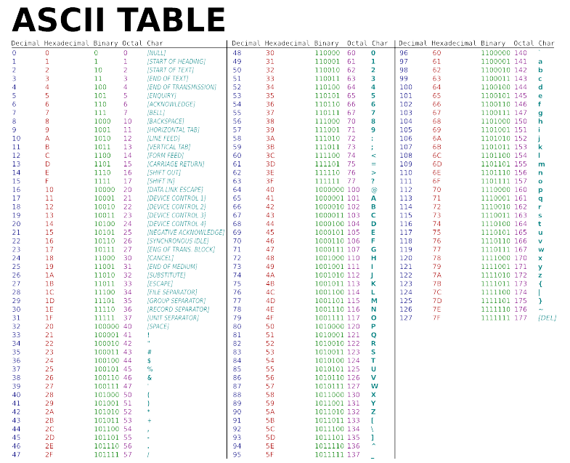
Data Representation
Text
- bit pattern, sequence of 0’s and 1’s
- different set of patterns (code) is used to represent text symbols
Unicode – uses 32 bits to represent a symbol or character used in any language in the world
American Standard Code for Information Interchange (ASCII) – uses 8 bits and constitute the first 127 characters in Unicode

Slide 9
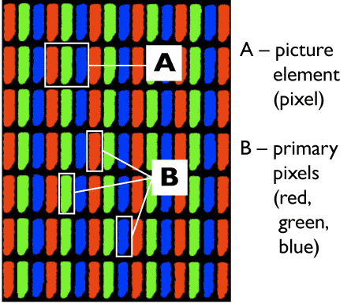
Data Representation
Numbers
- represented as bit patterns but is directly converted to a binary number
ex. Number 5 is represented as 00000101
Images
- bit patterns represented as a matrix of picture elements (pixels)
http://courseweb.stthomas.edu/

Slide 10
Data Representation
Audio
- recording or broadcasting of sound or music
- represented by a continuous signal
Video
- recording or broadcasting of a picture or movie
- can be
- Continuous: via TV Camera
- Discrete: via combination of images (frames)

Slide 11
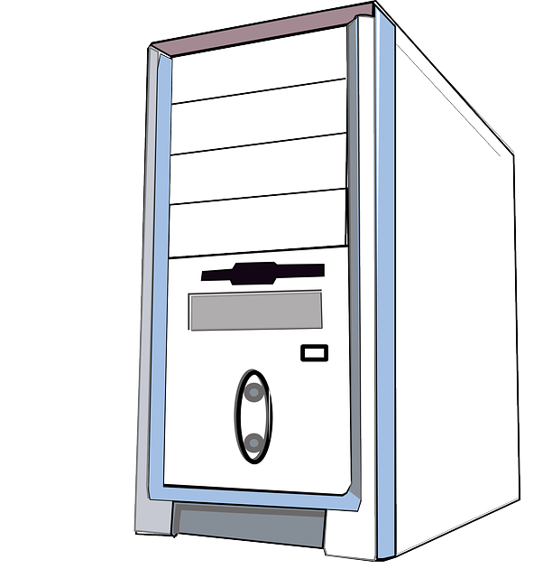



Data Flow
Simplex
Half-duplex
Full duplex / duplex

Slide 12
Network

Slide 13


Network
Interconnection of a set of devices capable of communication
Devices can be:
  Host (end-system) like large computer, desktop, laptop, mobile phone, or security system
  Connecting device like router, switch or modem
Uses distributed processing
  A task is divided among multiple computers

Slide 14
Network Criteria
Performance
Can be measured in many ways, including:
  Transmit time – amount of time required for a message to travel from one device to another
  Response time – elapsed time between an inquiry and a response
Depends on the number of users, type of transmission medium, capabilities of connected hardware, efficiency of software
Ideal metrics: more throughput, less delay

Slide 15
Network Criteria
Reliability
Measured by the frequency of failure, the time it takes a link to recover from a failure, and the network's robustness in a catastrophe
Security
Protecting data from unauthorized access, protecting data from damage, implementing policies and procedures for recovery from breaches and data losses

Slide 16
Network Attributes

Slide 17

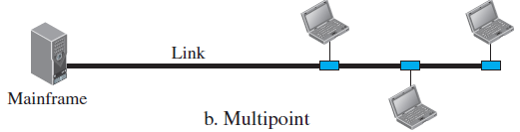
Physical Structure: Type of Connection
Point to Point
Multipoint / Multidrop

Slide 18
Physical Structure: Topology
Refers to the way in which a network is laid out physically
Geometric representation of the relationship of all the links and nodes to one another
  Mesh
  Star
  Bus
  Ring

Slide 19
Mesh
Every device has a dedicated point-to-point link to every other device
Number of duplex-mode links: n(n-1)/2
  How many links for 5 nodes?
Advantages
  No link sharing, robust, privacy or security,makes fault isolation easy
Disadvantage
  High cost
ex. Regional telephone connections
5 (5 – 1) / 2 = 10

Slide 20
Mesh

Slide 21
Star
Has a dedicated point-to-point link only to a central controller called a hub
No direct traffic between devices, controller relays traffic
Advantages
  Cheaper than mesh, easy to install and reconfigure, robustness
Disadvantage
  Hub is the single point of failure, sometimes more cabling is required

Slide 22
Star
Hub

Slide 23
Bus
Uses multipoint connection
Backbone cable links all devices in the network
Connection is via drop lines and taps
Advantages
  Ease of installation, cost less
Disadvantages
  Difficult reconnection and fault isolation, reduced quality because of signal reflection in taps, single break in backbone stops all transmission

Slide 24
Bus
Drop line
Cable end
Cable end
Tap

Slide 25
Ring
Each device has a dedicated point-to-point link with only two devices on either side of it (physically or logically)
Signal passed along the ring in one direction, from device to device, until it reaches its destination
Repeaters regenerate the signal intended for another device
Advantages
  easy to install and configure, simplified fault isolation
Disadvantage:
  a break in the ring can disable the network (solved by using a dual ring)

Slide 26
Ring
Repeater

Slide 27
Network Types

Slide 28
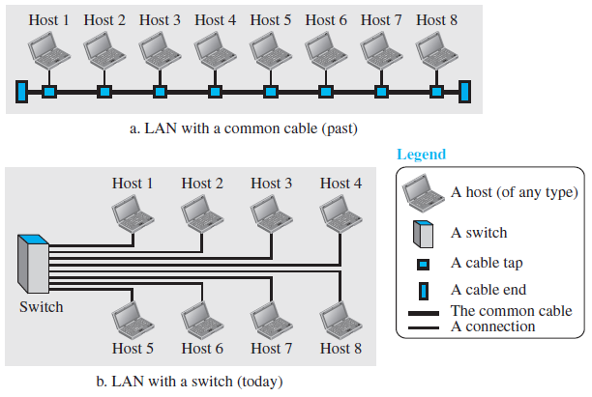
Local Area Network (LAN)
Interconnects hosts
Usually privately owned; can be as simple as two PCs and a printer
Limited to a few kilometers, spanning an office, a building or campus

Slide 29
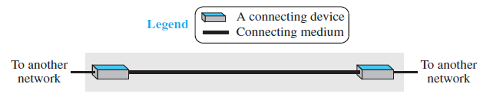
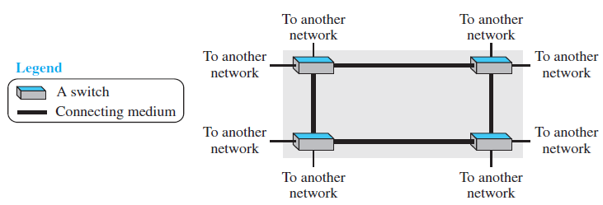
Wide Area Network (WAN)
Interconnects connecting devices
Normally created and run by communication companies
Long distance transmission of data
Point to Point WAN
Switched WAN

Slide 30
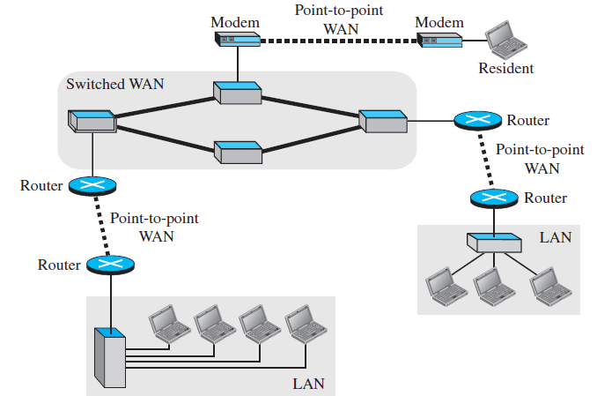
internetwork
When 2 or more networks are connected

Slide 31
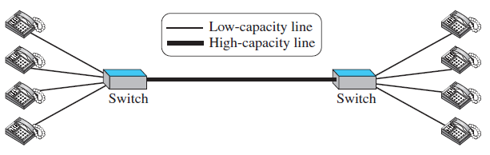
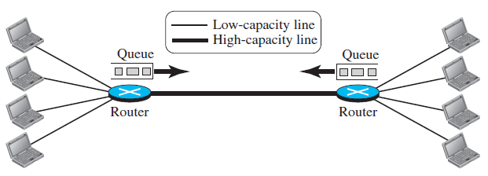
Switching
An internet is a switched network in which a switch connects at least two links together
Circuit-switched Network
Packet-switched Network

Slide 32
Reference
Forouzan, B.A. 2013. Data Communications and Networking, 5th Ed. McGraw-Hill, New York.

